Slide 1
Reacting to crises: the COVID-19 impact on biostatistics/epidemiology
Robert T. O’Neill Ph.D.

Slide 2
This talk is based upon an article of similar title published in Contemporary Clinical Trials in 2021

Slide 3
Crises often provide opportunities for change and new perspective or approaches
COVID 19 has already impacted how we manage public health crises, at the state, federal and local levels – science and biostatistics has been in the news virtually every day
Graphics of new cases , deaths, vaccination rates, breakthrough cases, testing rates, etc
Epidemiological models of transmission , projections of cases and deaths; use of ‘flatten the curve’ to influence policy
Vaccine study designs, treatment protocols are being impacted now
Role of clinical trials to demonstrate efficacy and safety

Slide 4
Three experiences/crises that changed things
The AIDS crisis, the approval of the drug Azidothymidine (AZT), surrogate endpoints and clinical trial networks and advances
The emergence of the science of safety assessment: large scale clinical safety studies and the active surveillance Sentinel System based upon millions of accessible electronic medical records
Efficiency in global drug development: International collaboration (ICH) to develop common standards for acceptance of clinical research – its impact on statistical practice

Slide 5
Impact of the AIDS crisis
New organizational resources devoted to facilitating RCTs and public discussions of clinical study design approaches – patient advocates
FDA – New division of Anti-viral Drug Products, Advisory Committee process meeting with NIH, public comment, AIDS activist impact on study designs
NIH – NIAID set up clinical trial network similar to NCI’s network of cancer trials (ECOG, SWOG) ; called ACTG (AIDS clinical trial group); data center at Harvard School of Public Health ,Center for Biostatistics in AIDS Research
Created Division of Biostatistics, hired Dr. Susan Ellenberg to lead it

Slide 6
Impact of the International Conference for Harmonization (ICH)
Brought together biostatisticians from industry, academia and regulators from Japan, European Union, United States to develop common guidance for global drug development
ICH E9 ‘ Statistical Principles for Clinical Trials’ published in 1998, has had seminal impact on randomized clinical trials and statistical expertise – recently updated with the ‘estimand’ addition to address missing data and intercurrent events
ICH E10 ’Choice of control groups’; stimulated research in Non-Inferiority Designs
E17 Multi-center- Multi-regional clinical trial guidance
Adaptive design guidance in process
Good Clinical Practice update ICH E6(R1) and E8 clinical trials

Slide 7
A new era of quantitative safety assessment and surveillance – - the impact of decades of drug induced adverse event experiences and safety profiles for new drugs: cardiovascular events for NSAIDS, diabetes drugs, weight loss drug, etc
Weight reducing drugs, fenfluramine and dexfenfluramine associated with cases of cardiovascular valvulopathy in women
Anti-diabetic drug adverse events
NSAID drug and cardiovascular events; Vioxx
Large scale randomized trials to rule out or detect increased risk of known or unknown adverse events

Slide 8
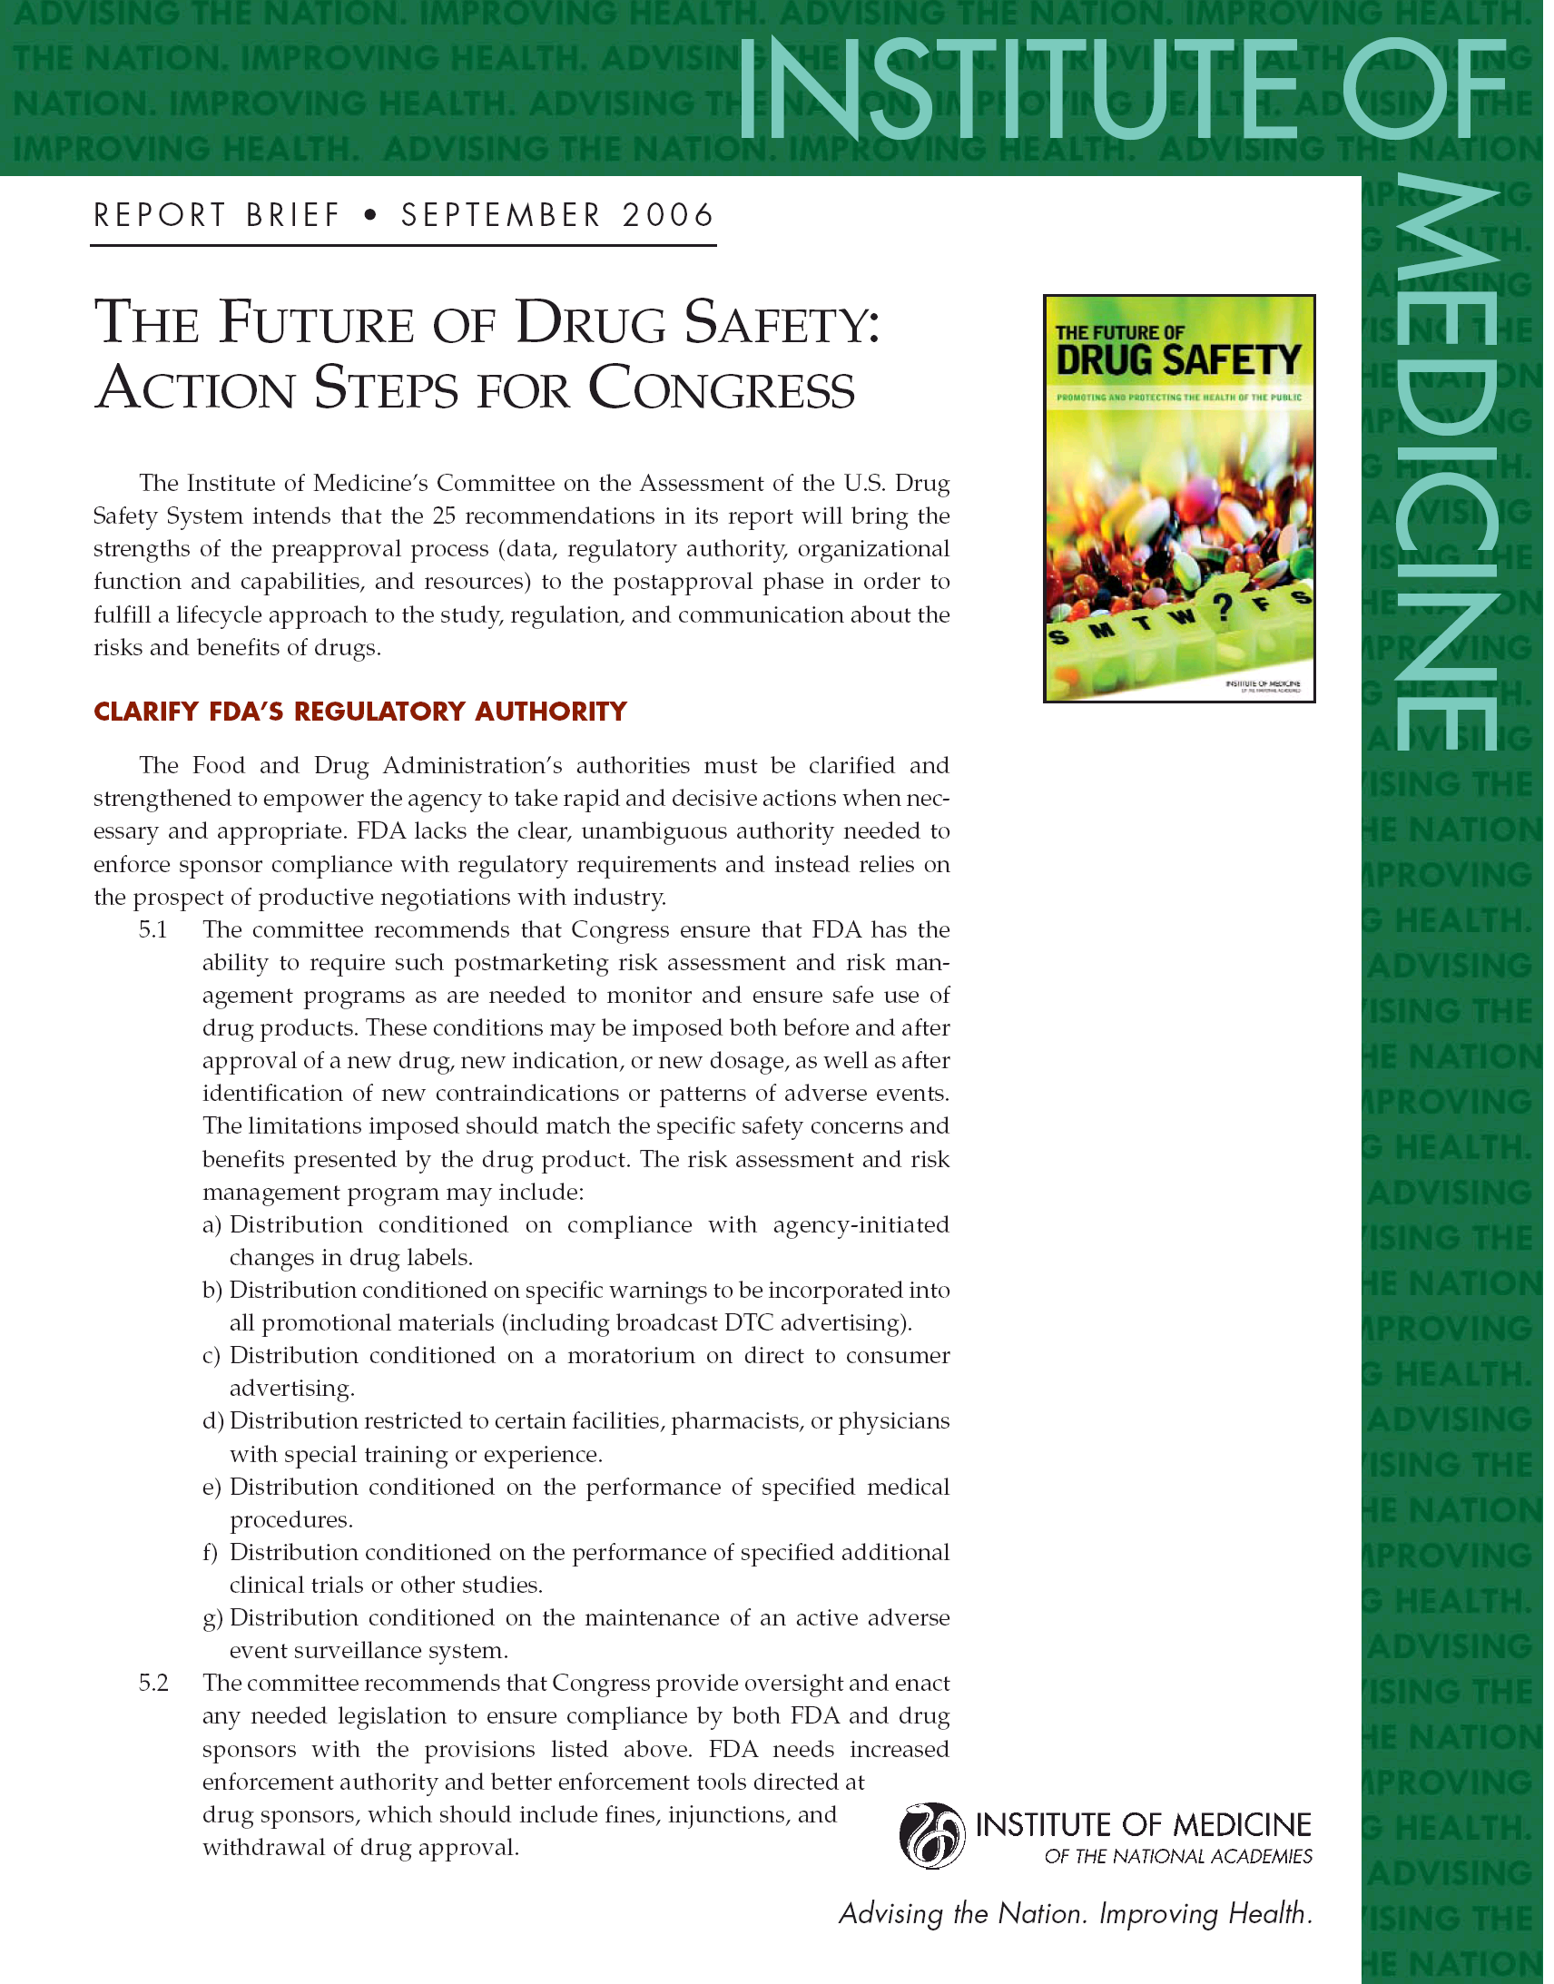
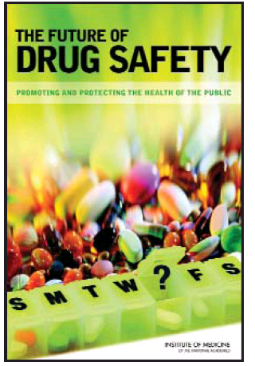
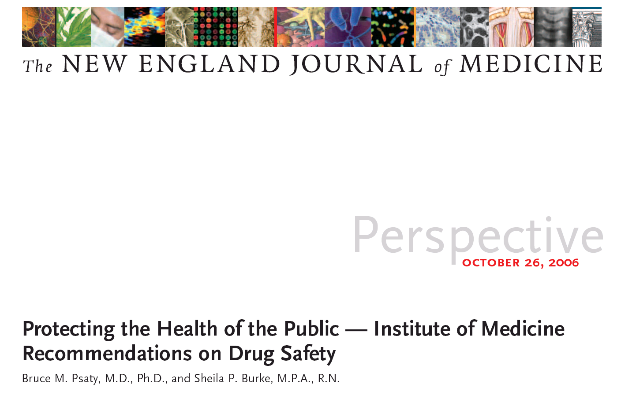

Slide 9
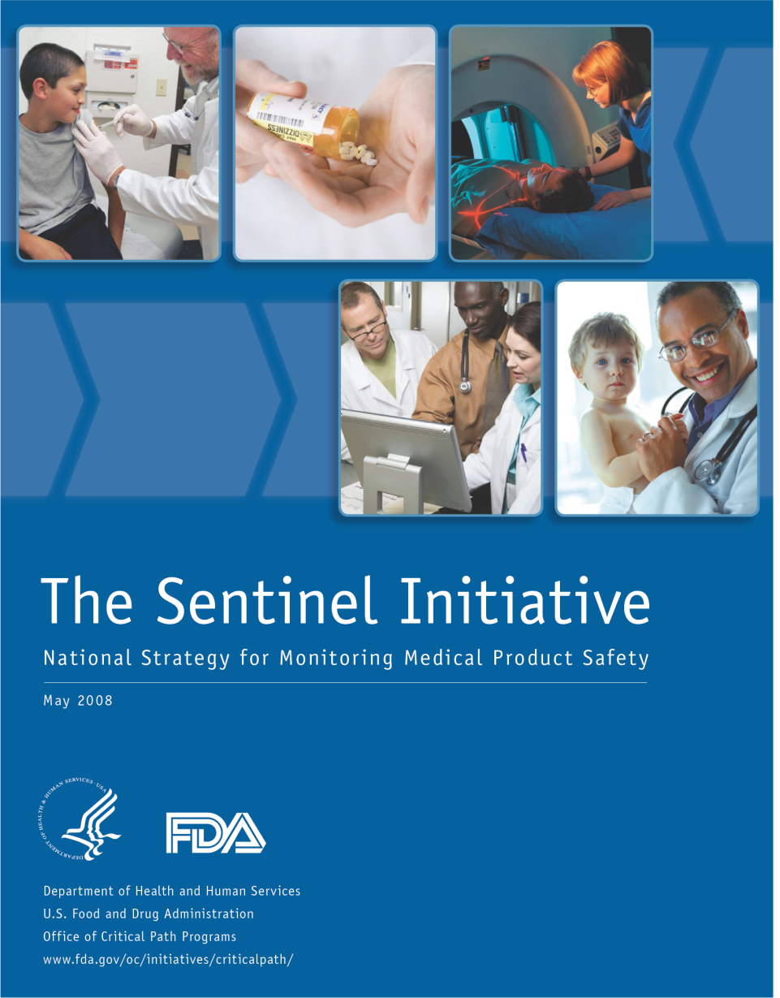
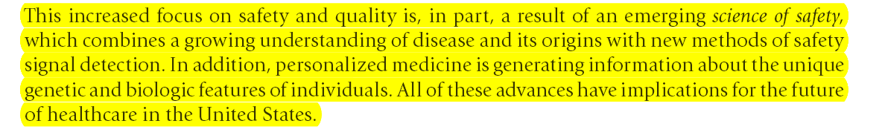
The Emerging Science of Safety Mandate for active surveillance of electronic medical records

Slide 11
Some messages from that webinar
The impact of urgency on:
Network development
Collaborations across organizations to coordinate trial designs and endpoints
Identifying gaps and limitations to our current systems
More community based trials to increase diversity and representative populations in research
Better training to incorporate methods into a learning health care system
Real world data – its use and limitations

Slide 12
Lessons learned from the COVID-19 pandemic
Importance of collaboration among multiple stakeholders
Operationalize innovation
Study designs
Networks
Standardization of terms, outcomes
Recognitions of many limitations we have in the health system – will there be fix

Slide 13
Washington Post article, October 2, 2021
Operating on patchwork system collecting data from states, no central surveillance system, no critical data to address fundamental questions of incidence, risk factors, slowness in aggregation, etc.

Slide 14
Impact of Covid-19 on clinical trials and development: recent regulatory guidance
European Medicines Agency – one guidance
Food and Drug Administration – two guidances on clinical trials, one guidance on statistical considerations
Real world data guidance

Slide 16
Listen to web recordings (You Tube) of FDA advisory committees on EUA for Pfizer, Moderna, J&J vaccines, and on deliberations for boosters
NIH sponsored study on mix and match of vaccines and boosters
An adaptive design with many combinations of sequence of vaccine shots
Antibody response , not clinical outcomes
Not designed for head to head comparisons

Slide 17
Current and Future contributions of biostatistics and epidemiology to manage COVID-19 and other pandemics
Sentinel System, and other real time surveillance networks
OHDSI (Observational Health Data Science and Informatics ) Community –Methods research for COVID-19, characterization, estimation, prediction
EUMAEUS; Evaluating Use of Methods for Adverse Event Under Surveillance (Eureapean wide initiative)
Real world data use: electronic records to study vaccine effectiveness
Reagan –Udall Foundation web site
Regulatory guidance on RCTs for Covid treatments, and more use of Master Protocols (test many drugs against common control)

